Slide 1
Capstone final project- The battle of neighborhood of Paris
Coursera IBM Data Science Certification
Z.Mekharbeche

Slide 2
Report content
1.PURPOSE
2.INTRODUCTION
3.OBJECTIVES
4.METHODOLOGY
5.RESULTATS SECTION
6.DESCUSSION SECTION
7.CONCLUSION

Slide 3
1.PURPOSE
This document provides the report of my final capstone project for the IBM Data Science Professional Certificate.

Slide 4
2.INTRODUCTION
My dream project is to open a franchise of Japanese restaurants. It's a new concept of restaurant without waitress. Food moves on a conveyor to the customer and the customer chooses what he wants to eat. I expect that this concept will be very successful because people here in France love Japanese food. The idea is to open a first franchise of this restaurant in a strategic location in Paris, deploy the necessary efforts for it's success and then open other franchises in the various boroughs of Paris and in the other cities.

Slide 5
3.OBJECTIVES
In this project, we will study the areas of Paris order to determine which neighborhoods have the highest concentration of sushi restaurant in order to solve our business problem.
A description of the problem and discussion of the background
The challenge to resolve is being able to find a place in Paris to open my new restaurant with the following conditions: - located in place with less competition.
Interested Audience
I believe this is a relevant project for any person how want to open a restaurant in any city, it will be very interesting for franchises companies. The approach and methodologies used are applicable for all cases.

Slide 6
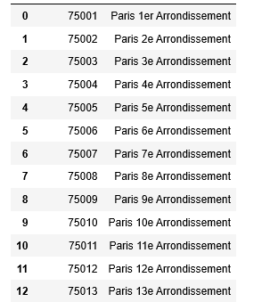
4.METHODOLOGY
Data Required to resolve the problem
To do that, we will use the Foursquare API to explore neighborhoods in Paris. We will use the explore function to get the most common venue categories in each neighborhood, and then use this feature to group the neighborhoods into clusters. We will use the k-means clustering algorithm to complete this task

Slide 7
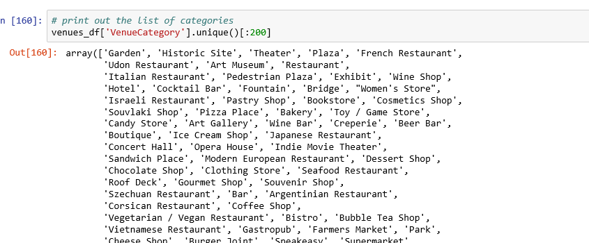
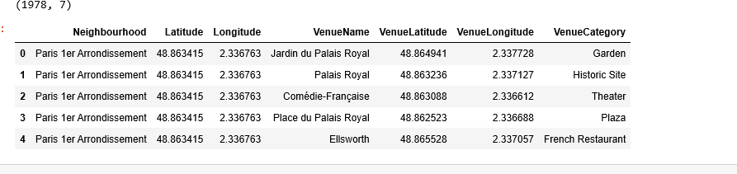
Segmenting and Clustering Neighborhoods
We used Foursquare API to explore avenues of Paris neighborhoods.

Slide 8
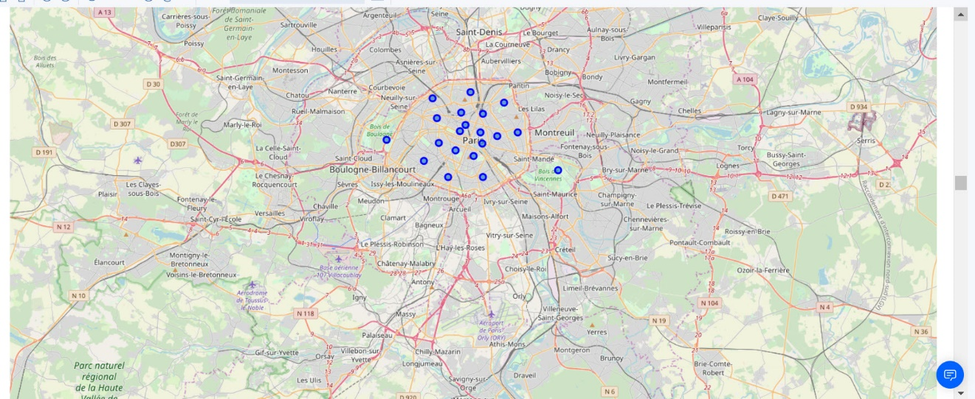
Map of Paris neighborhoods

Slide 9
Explore Neighborhoods of Paris
We used Foursquare API to explore avenues of Paris neighborhoods

Slide 10
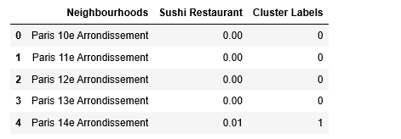
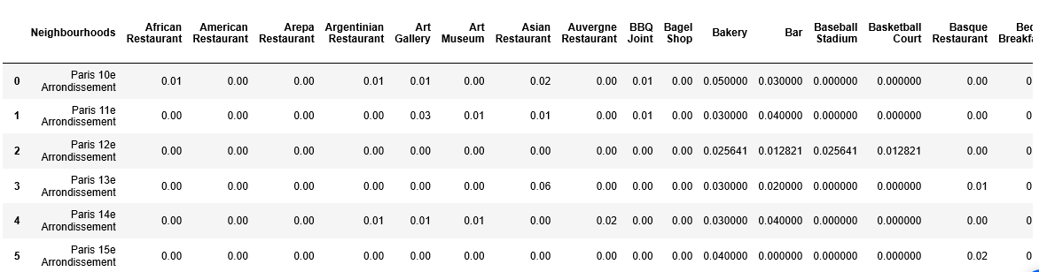
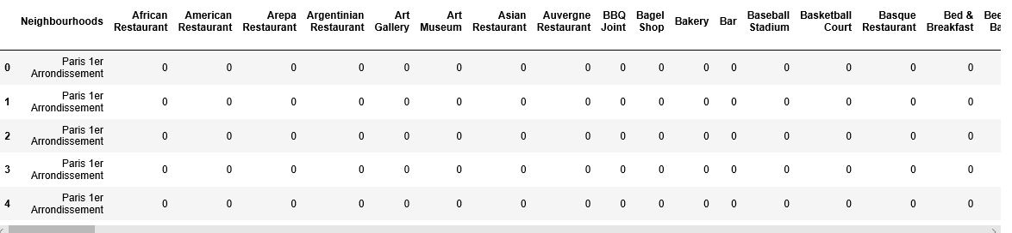
Analyze Each Neighborhood
We cluster avenue for category Sushi restaurant.

Slide 11
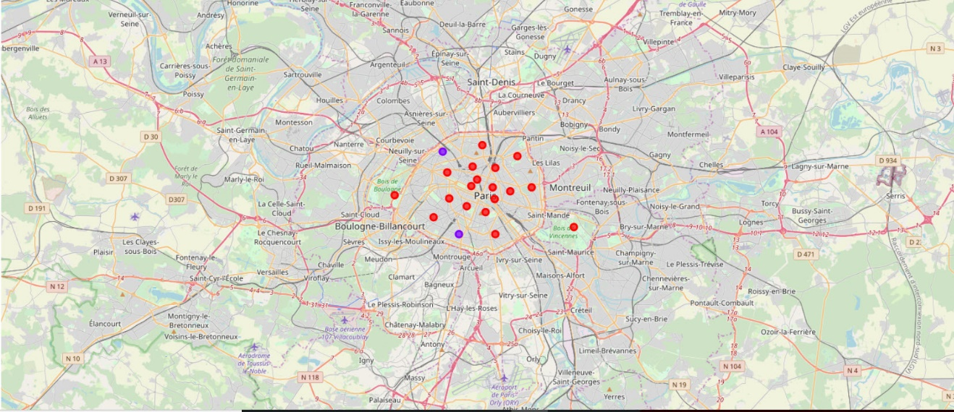
Map of Paris neighborhoods with clustering

Slide 13
3.Results Section
We followed the methodology that way described above and came to the conclusion that most neighborhood of Paris represent a good opportunity to lunch the new concept of Sushi Restaurant since the was less competition in most of the areas.

Slide 14
4.Discussion Section
Observations that I made during this analysis were that Paris has many areas and neighborhoods where we can start a new concept Sushi Restaurant . Knowing that people in Paris are very open to Asian food that will encourage us to invest in this type of restaurants.

Slide 15
5.Conclusion Section
In conclusion, we have shown that k-means clustering combined with Foursquare API data can be used to make business recommendations. We were able to cluster area in a specific neighborhood that optimizes our chances for success.

